Slide 1
Cubic Splines: What are splines and how are they used?
Steve Simon

Slide 2


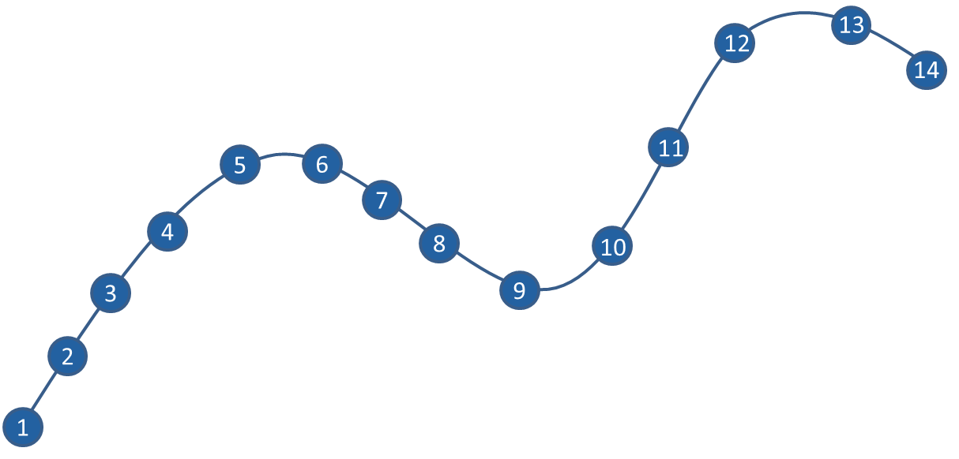
Where this fits
Extensions of Linear Models
Refine the Model and Check Model Fit

Slide 3
What You’ll Learn Today:
Variety of regressions
Building cubic splines from scratch
B-splines
How many knots and where to put them
Logistic regression example
Some code hints for R, SAS, Stata
Notes:
“What are cubic splines and when do you need to use them?”
Splines provide a useful way to model relationships that are more complex than a simple linear function. They work with a variety of regression models. They rely on some simple mathematical concepts: continuity and smoothness. You will see some simple applications where continuity and smoothness are important and learn how to use splines for linear regression and the generalized linear model.

Slide 4
xkcd comic
Title “CURVE-FITTING METHODS AND THE MESSAGE THEY SEND”
Drawn by Scott Munro
Open-source license
Link to comic at xkcd.com
More details at explain-xkcd.com
Notes:
Let me start with a cartoon from the xkcd site of Scott Munro. Scott Munro produces comics that poke fun at various scientific and mathematical concepts. There are a handful that directly address statistics, including this one. The actual panels in the comic are small, so I split them up onto separate slides.

Slide 5
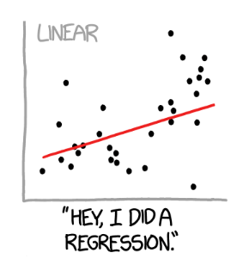
xkcd comic, panel 01
Notes:
This shows a scatter of data points with a linear regression fit. The caption reads, “Hey, I did a regression.”

Slide 6
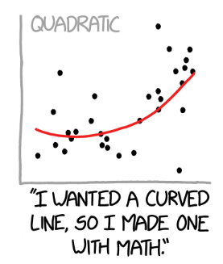
xkcd comic, panel 02
Notes:
This shows a scatter of data points with a quadratic regression fit. The caption reads, “I wanted a curved line, so I made one with Math.”

Slide 7
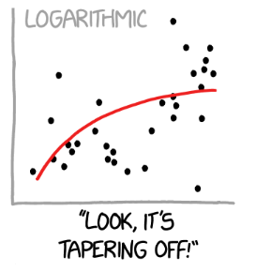
xkcd comic, panel 03
Notes:
This shows a scatter of data points with a logarithmic regression fit. The caption reads, “Look, it’s tapering off!”

Slide 8
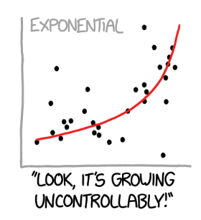
xkcd comic, panel 04
Notes:
This shows a scatter of data points with an exponential regression fit. The caption reads, “Look, it’s growing uncontrollably.”

Slide 9
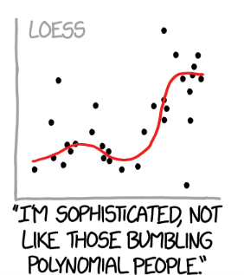
xkcd comic, panel 05
Notes:
This shows a scatter of data points with a loess smoothing curve. The caption reads, “I’m sophisticated, not like those bumbling polynomial people.”

Slide 10
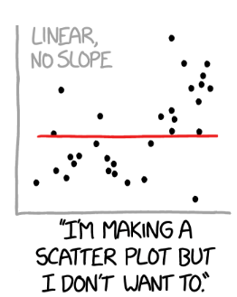
xkcd comic, panel 06
Notes:
This shows a scatter of data points with a flat linear regression fit (slope=0). The caption reads, “I’m making a scatter plot but I don’t want to.”

Slide 11
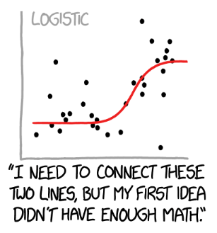
xkcd comic, panel 07
Notes:
This shows a scatter of data points with a logistic curve regression fit. The caption reads, “I need to connect these two lines, but my first idea didn’t have enough Math.”

Slide 12
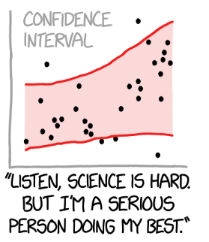
xkcd comic, panel 08
Notes:
This shows a scatter of data points with no particular regression line, but a very wide (nd probably appropriate) confidence band. This captures the idea that there is uncertainty not only in the deviation of the points from the regression curve, but true uncertainty about the shape of that regression curve. The caption reads, “Listen, science is hard. But I’m a serious person doing my best.”
There is an active field of research under the topic uncertainty quantification that tries to take into account all the sources of uncertainty including uncertainty about which model is the correct model.

Slide 13
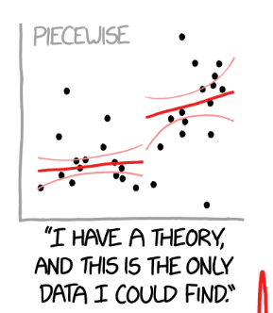
xkcd comic, panel 09
Notes:
This shows a scatter of data points with a piecewise linear regression fit. The caption reads, “I have a theory and this is the only data I could find.”

Slide 14
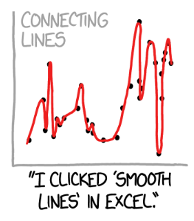
xkcd comic, panel 10
Notes:
Here the proposed regression model gets a bit silly. This shows a scatter of data points with a smooth curve connecting every data point. The caption reads, “I clikced ‘smooth lines’ in Excel.”

Slide 15
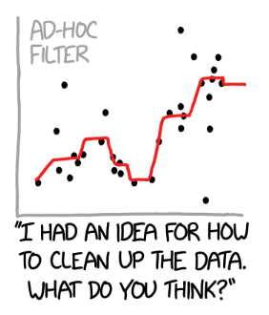
xkcd comic, panel 11
Notes:
This shows a scatter of data points with a smoother that looks like it uses medians somehow. The caption reads, “I had an idea for how to clean up the data. What do you think?”

Slide 16
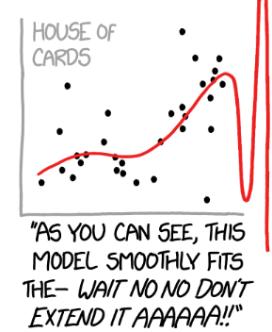
xkcd comic, panel 12
Notes:
This shows a scatter of data points with what looks like a B-spline. The caption reads, “As you can see, this model smoothly fits the - Wait, No, No, Don’t extend it. AAAAAA!!”

Slide 17

Examples of splines, 1
Notes:
Here’s a peer-reviewed study of sleep duration and how it relates to your gut microbiota–all those tiny bugs living inside your intestines. The authors used a composite score called the dietary index for gut micrtobiota with the acronym DI-GM. This article is published under an open source license, like all the other papers you will see today.
Liu J, Huang S. Association between dietary index for gut microbiota and sleep duration in US adults: a cross-sectional study. Curr Res Microb Sci. 2025 May 27;9:100412. doi: 10.1016/j.crmicr.2025.100412. PMID: 40528895; PMCID: PMC12171763.

Slide 18
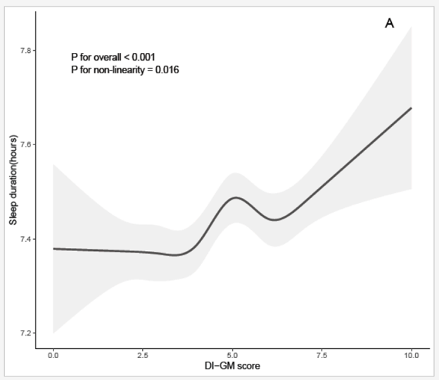
Examples of splines, 2
Notes:
The cubic spline starts out flat for low values of DI-GM, then rises, dips, and rises again.

Slide 19

Examples of splines, 3
Notes:
Here’s another open source article, a peer-reviewed study of patients with Duchene muscular dystrophy (DMD). The authors measured spine bone mineral density and sought to see how that related to various cholesterol measures, including triglycerides and remnant cholesterol both in patients with DMD and age-matched healthy controls. The authors controlled for a variety of factors including steroid use.
Wang Y, Chang Y, Zhang P, Zheng Z, Ai X, Zhang S, Wu S. Association between triglycerides and remnant cholesterol levels and spine bone mineral density in Duchenne muscular dystrophy. Lipids Health Dis. 2025 Jun 9;24(1):209. doi: 10.1186/s12944-025-02628-0. Erratum in: Lipids Health Dis. 2025 Jun 27;24(1):222. doi: 10.1186/s12944-025-02646-y. PMID: 40490739; PMCID: PMC12147359.

Slide 20
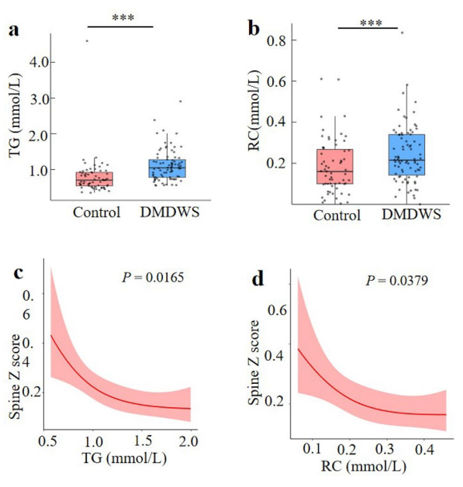
Examples of splines, 4
Notes:
The box plot examines DMD patients without corticosteroid treatment (DMDWS) to the healthy controls. Triglycerides and remnant cholesterol was elevated in the DMDWS group. The cubic spline shows a deline in bone health for larger values of triglycerides and remnant cholesterol, but the effect is not quite as strong for larger values of these cholesterol measurements.

Slide 21

Examples of splines, 5
Notes:
Here’s a peer-reviewed study of how nutrtion is associated with the risk of chronic kidney disease (CKD). The authors got their data from the National Health and Nutrition Examination Survey (NHANES) data, a large scale CDC survey that includes a medical exam and dietary history. They estimated niacin intake through a dietary recall and classified patients as having CKD based on their Albumin to creatinine ratio and the estimated glomerular filtration rate.
Hu C, Tang T. Association between niacin intake and chronic kidney disease in male participants-a cross-sectional study from the NHANES (2005-2018). Front Nutr. 2025 Jun 13;12:1578118. doi: 10.3389/fnut.2025.1578118. PMID: 40584108; PMCID: PMC12202428.

Slide 22
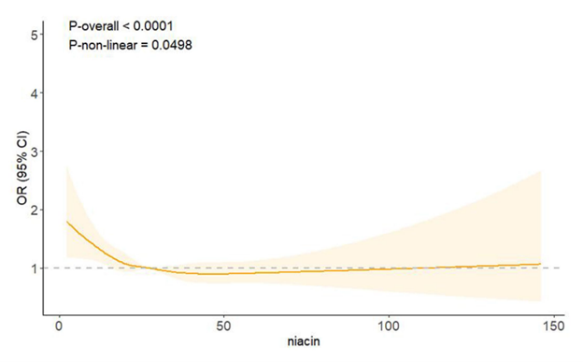
Examples of splines, 6
Notes:
The cubic spline shows that a deficiency of niacin increases the odds of CKD, but that larger levels of NIACIN above 20 to 30 do not have an impact.

Slide 23
A real-world problem, without the data
Threshold model
Nothing happens until you meet a threshold
Then things get worse
Notes:
Several decades ago, I was faced with a data analysis problem. I wanted to fit a threshold model where everything is fine and normal until the exposure level meets a certain threshold. Then things get worse.
I don’t have the data for this problem but let me illustrate conceptually how a threshold model might work. It provides a simple but useful analog to regression splines.

Slide 24
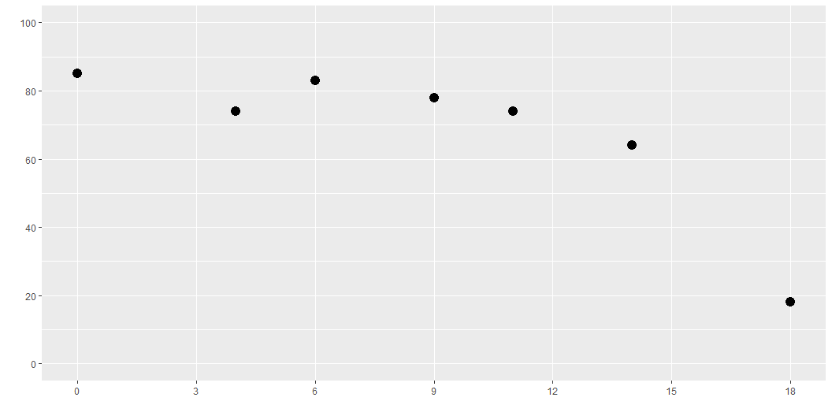
Fake data

Slide 25
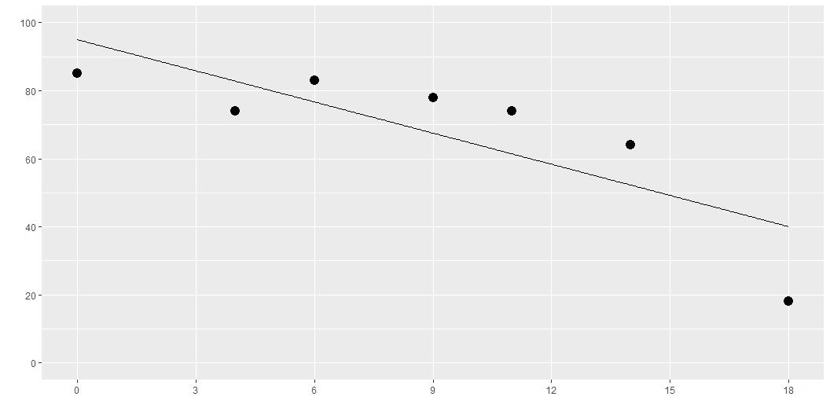
Linear function
Notes:
Here is what a linear function might look like. It is not what we want, but always start with the easiest model.

Slide 26

Computational formula for linear regression
$$X=\left[\begin{matrix}1 & 0 \\ 1 & 4 \\ 1 & 6 \\ 1 & 9 \\ 1 & 11 \\ 1 & 14 \\ 1 & 18\end{matrix}\right]$$
$$\hat{β}={\left(X′X\right)}^{−1}X′Y$$
Notes:
This is the matrix formula for linear regression. Don’t worry if you haven’t used matrices before. Just focus on how the X matrix is laid out for linear regression. The first column is all 1’s and the second column contains the X values.
In multiple linear regression, you would have additional columns, but let’s keep it simple for now.
I do want to note here that you can get a different regression model by changing the second column.

Slide 27
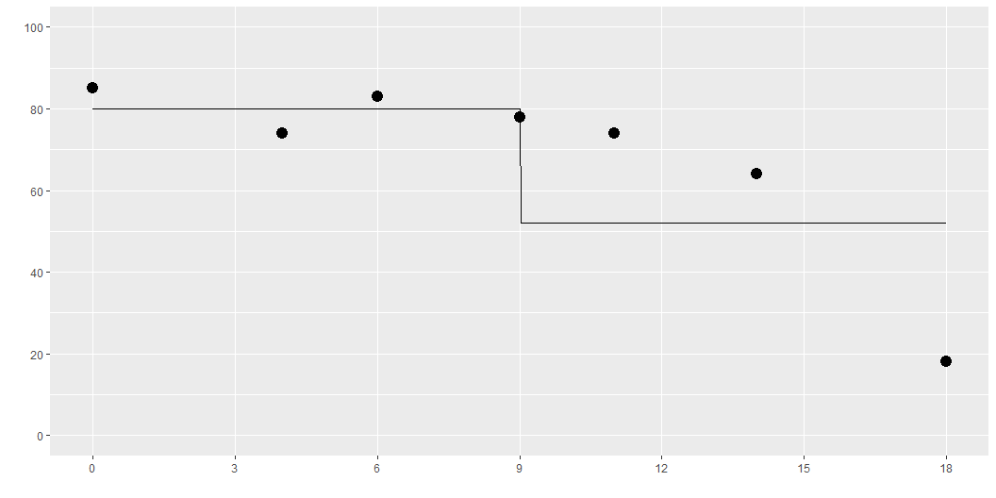
Step function
Notes:
Here is what a step function might look like. It is better than a linear fit, but the sudden jump at x=9 is not quite what you want.
This is a discontinuous function. It might make sense in some settings. In other settings, you might expect the decline to be not so sudden and abrupt.

Slide 28

Computational formula for step regression
$$X=\left[\begin{matrix}1 & 0 \\ 1 & 0 \\ 1 & 0 \\ 1 & 0 \\ 1 & 1 \\ 1 & 1 \\ 1 & 1\end{matrix}\right]$$
$$\hat{β}={\left(X′X\right)}^{−1}X′Y$$
Notes:
This is the matrix you would use if you wanted a step regression model. The first column is all 1’s and the second column is zero for X values of 9 or less and 1 for X values larger than 9.
Notice that the matrix formula has not changed. You are familiar with all the mathematical properties for linear regression. You know how to get confidence intervals and hypothesis tests for linear regression. The step regression model will use pretty much the same formulas, just with a slight tweak to the X matrix.
More importantly, any statistical software that can compute a linear regression can also compute a step regression.

Slide 29
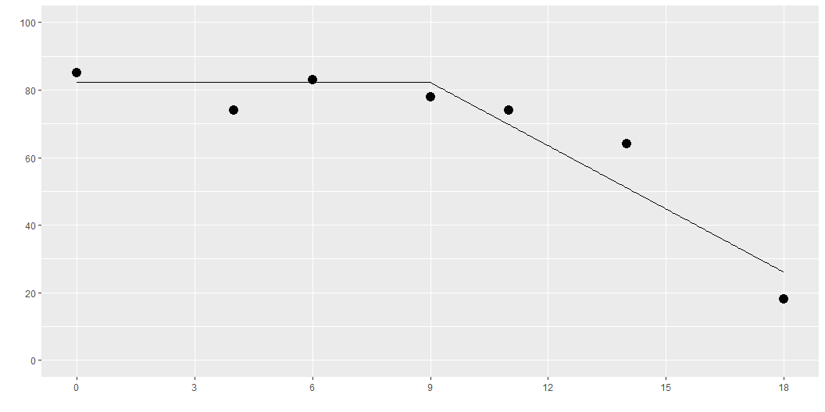
Elbow function
Notes:
A threshold model could look like this. It is a step function that is at a high level prior to the threshold at X=9 and then drops after.
Here is a better model. It is flat and at a high level for values less than 9 and declines linearly for values greater than 9.
Note the “elbow” at the threshold. This might be okay, but it might be better for a transition that does not change slope so suddenly.

Slide 30

Computational formula for elbow regression
$$X=\left[\begin{matrix}1 & 0 \\ 1 & 0 \\ 1 & 0 \\ 1 & 0 \\ 1 & 2 \\ 1 & 5 \\ 1 & 9\end{matrix}\right]$$
$$\hat{β}={\left(X′X\right)}^{−1}X′Y$$
Notes:
This is the matrix you would use if you wanted the elbow regression. The first column is all 1’s and the second column is zero for X values of 9 or less and (x-9) for X values larger than 9. Again, it is important to subtract the 9 because you want the linear section to just start descending at when X reaches 9.
Notice that the matrix formula still has not changed. Fitting an elbow regression is just as easy as a linear regression. You can do all the fun stuff and you can use the same software.

Slide 31
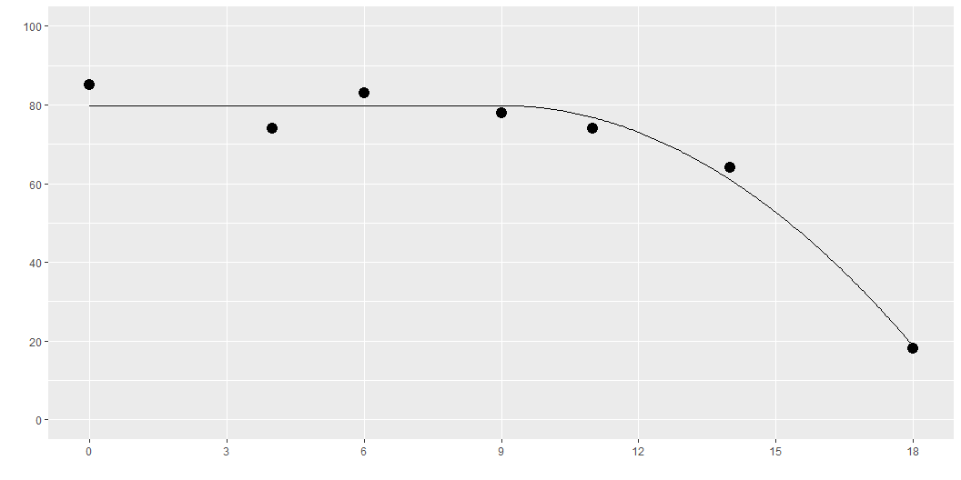
Quadratic analog
Notes:
Here is a functional form that avoid the elbow at the threshold value. It fits a quadratic decline, or a parabola, but the parabola starts at the point where the derivative is equal to zero.

Slide 32

Computational formula for quadratic analog
$$X=\left[\begin{matrix}1 & 0 \\ 1 & 0 \\ 1 & 0 \\ 1 & 0 \\ 1 & 4 \\ 1 & 25 \\ 1 & 81\end{matrix}\right]$$
$$\hat{β}={\left(X′X\right)}^{−1}X′Y$$
Notes:
This is the matrix you would use if you wanted the quadratic analog to the elbow regression. The first column is all 1’s and the second column is zero for X values of 9 or less and (x-9) squared for X values larger than 9. Again, it is important to subtract the 9 before squaring, because you want the quadratic curve to just start descending at when X reaches 9.
Notice that the matrix formula still has not changed. Fitting an elbow regression is just as easy as a linear regression. You can do all the fun stuff and you can use the same software.

Slide 33
Break #1
What you have learned
Variety of regressions
What’s coming next
2. Building cubic splines from scratch

Slide 34
Splines
Piecewise cubic polynomial
Continuous (no jumps)
Smooth (no sharp turns)
Transition points = knots
Notes:
A spline is a piecewise cubic polynomial. It converts from one cubic polynomial to a different cubic polynomial at pre-defined transition points known as knots. The individual cubic polynomials are constrained to be continuous and smooth at the knots. Continuous means no sudden jumps. Smooth means no sudden turns. You can also think of it as no elbows. Mathematically, smooth means a continuous first and second derivative.

Slide 35
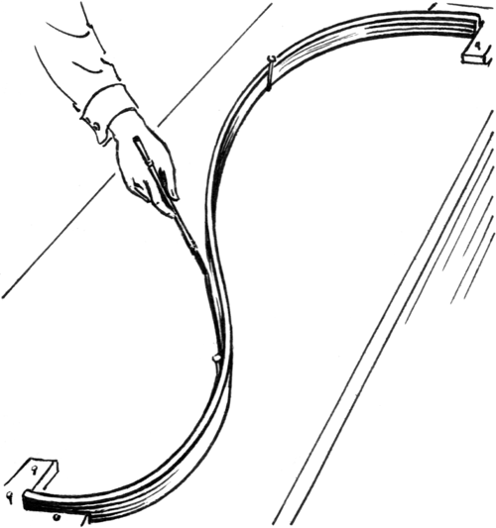
A physical spline
Notes:
Before computers became powerful enough to compute splines, we had several alternatives.
Here is an image from Wikipedia of physical spline. It is a thin strip of wood–thin enough to allow it to bend. It is constrained so that the bend follows a path that covers a few points.

Slide 36
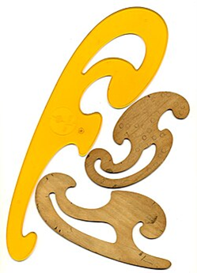
A french curve
Notes:
The french curve was a plastic template that showed a range of curvatures. You would line up the curve to four data points, draw along the french curve between the two interior points and then shift to the right and line up the french curve again. The resulting path looked seamless.

Slide 37
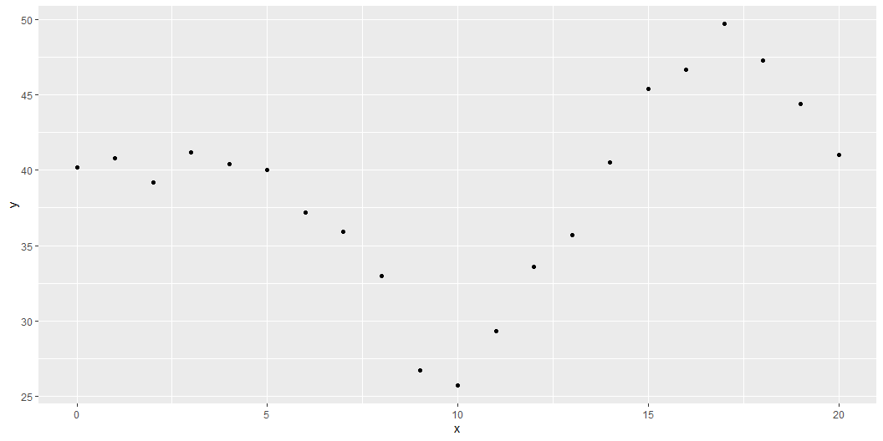
Graph of artificial data
Notes:
Here is some artificial data. I manipulated the data so that the behavior of the underlying trendfor x=0 to 5, x=6 to 10, x=11 to 15, and x=16 to 20.

Slide 38
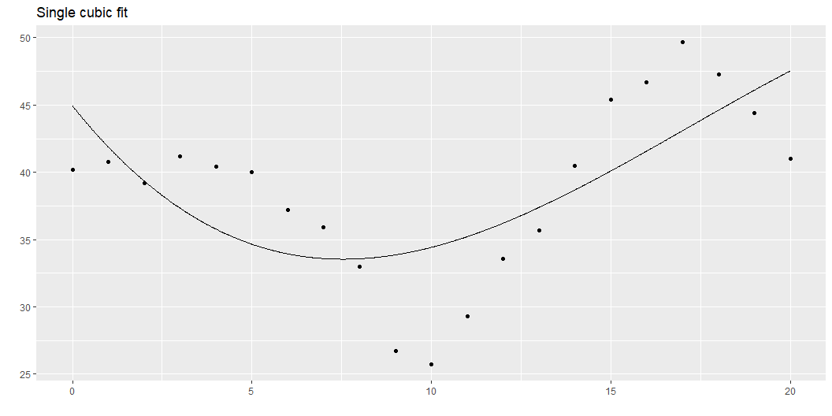
Single cubic polynomial
Notes:
The graph shown here represents the best fitting single cubic polynomial. It doesn’t fit the data very well. The problem is that the data is largely flat from 0 to 5 and then starts wiggling a lot from 5 onward. A cubic polynomial (or any polynomial for that matter) can be mostly flat or very wiggly but it generally can’t be both.
You need a way to transition between a wiggly cubic and a mostly flat cubic.

Slide 39
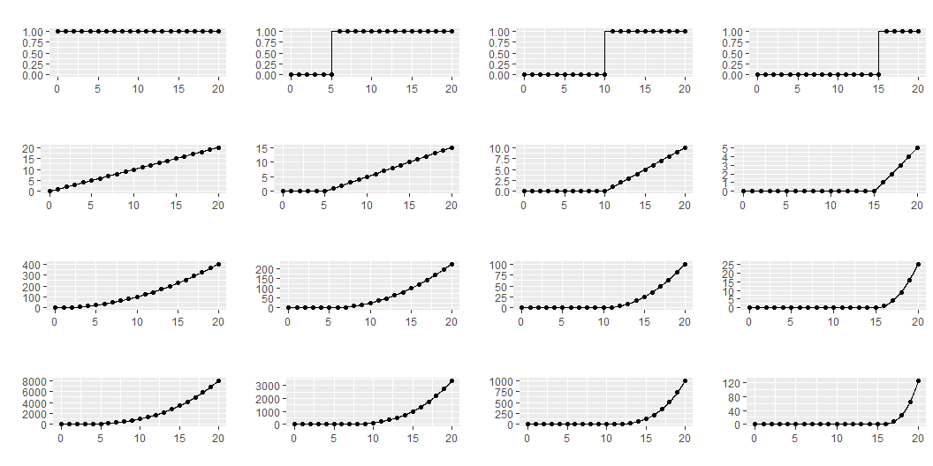
Cubic polynomials with knots at x=5, 10, 15

Slide 40
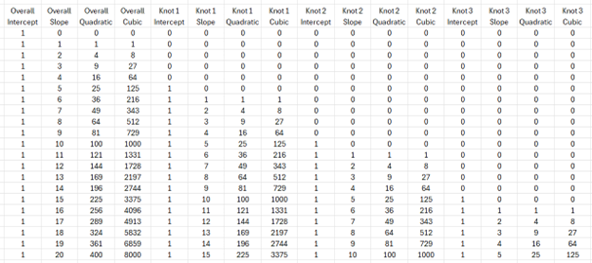
What the numbers look like
Notes:
This is what the raw numbers look like. I apologize for the size of the fonts. I want you to focus just on the patterns shown here.

Slide 41
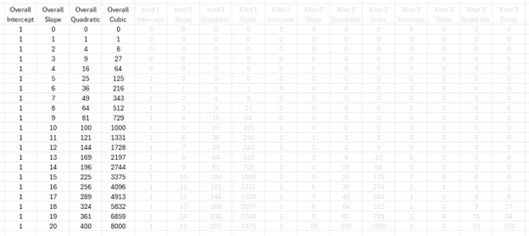
What the numbers look like, overall terms
Notes:
The overall terms are constant, linear, quadratic, or cubic across the entire range of the data.

Slide 42
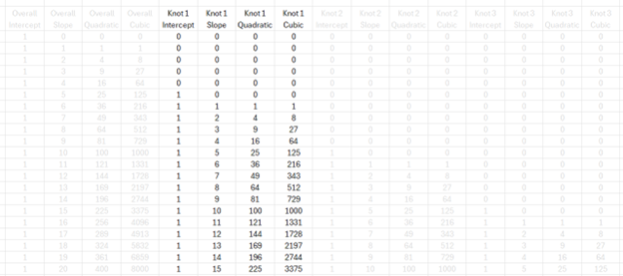
What the numbers look like, knot 1 terms
Notes:
The knot 1 terms are all zero until you hit x=5. Then they are constant, linear, quadratic, or cubic across the rest of the data.

Slide 43
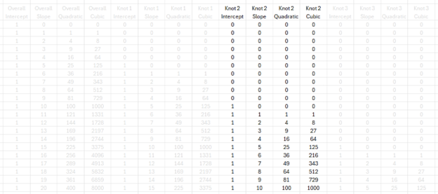
What the numbers look like, knot 2 terms
Notes:
The knot 1 terms are all zero until you hit x=10. Then they are constant, linear, quadratic, or cubic across the rest of the data.

Slide 44
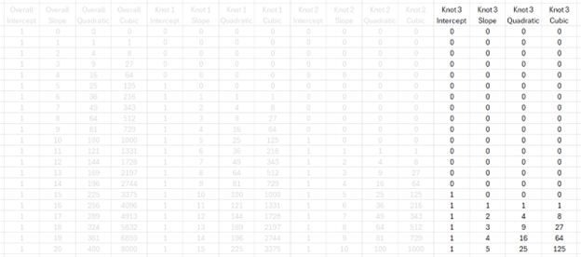
What the numbers look like, knot 3 terms
Notes:
The knot 3 terms are all zero until you hit x=15. Then they are constant, linear, quadratic, or cubic across the rest of the data.

Slide 45
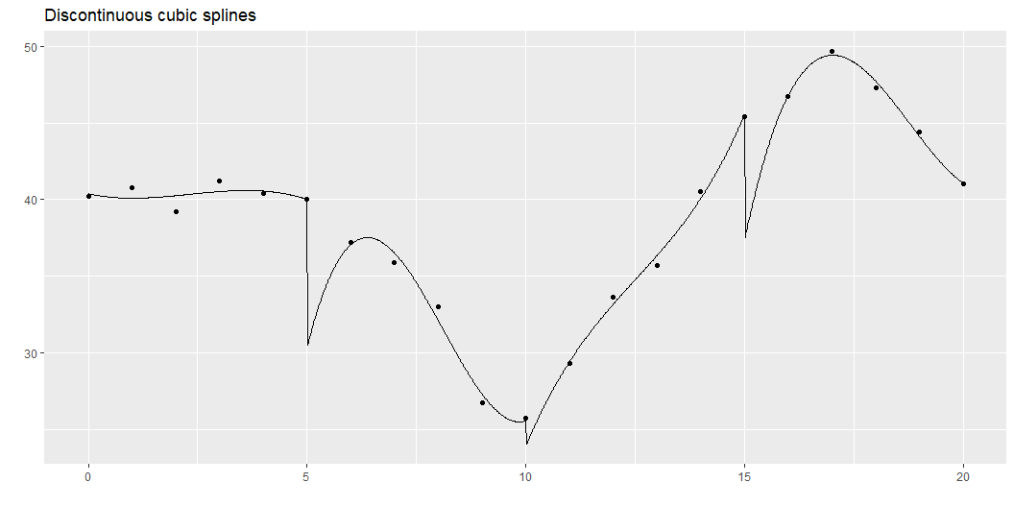
Discontinuous cubic spline
Notes:
So, we could fit a cubic model for the first five data points, for the second five, the third five, and the fourth five. This is a bit much: a cubic model has four parameters, so fitting four of them would use up 16 degrees of freedom in a data set with only 20 observations. But bear with me a bit on this.
The trick to fitting four separate cubic polynomials is to “restart” the intercept, linear, quadratic, and cubic terms after x=5, x=10, and x=15, as shown above. This leads to a model with 16 degrees of freedom. This is way too many degrees of freedom for only 20 data points, but it helps anchor a series of more reasonable models.
This function is not continuous or smooth. To make the function continuous, drop the extra intercept terms.

Slide 46
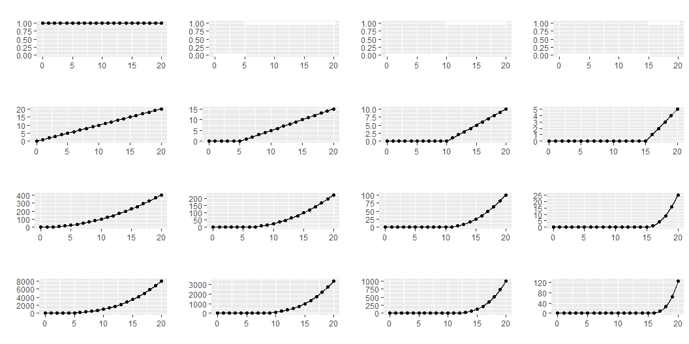
Remove piece-wise intercepts

Slide 47
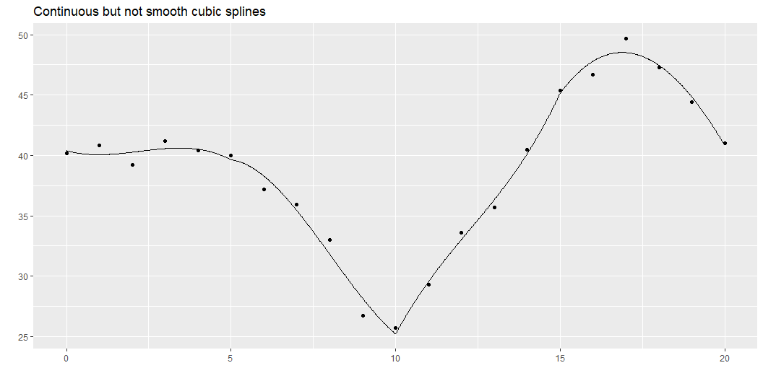
Continuous spline
Notes:
While this graph is continuous, it still takes some abrupt turns. What this curve lacks is smoothness. The mathematical concept of smoothness is measured in terms of the continuity of derivatives.

Slide 48
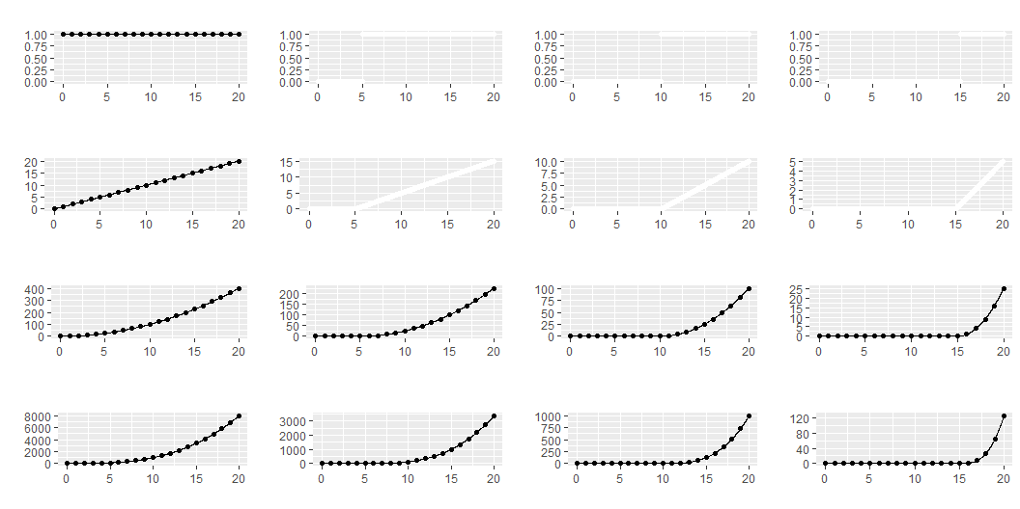
Remove piecewise linear terms

Slide 49
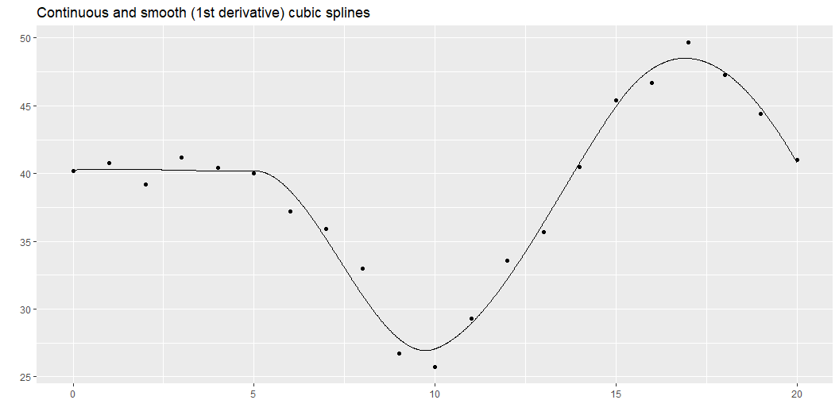
Smooth splines
Notes:
Here is a function that has a continuous first derivative. You fit this model by dropping the extra linear terms beyond the first one. Notice a pattern here. As you place additional restrictions on the spline (continuity, smoothness), you need fewer parameters. The four cubic models with no restrictions used up 16 degrees of freedom. When you added a continuity restriction, you only needed 13 degrees of freedom for the model. Add a smoothness restriction and you only need 10 degrees of freedom.

Slide 50
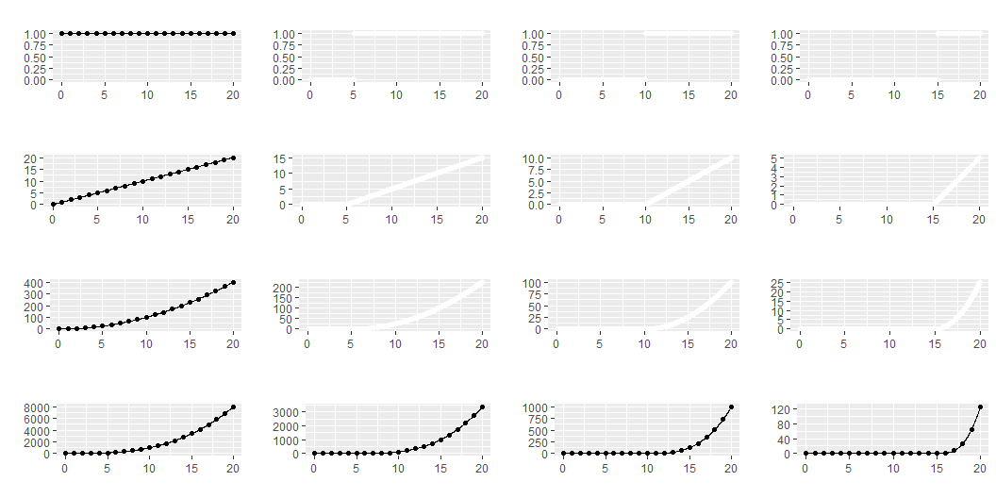
Remove piecewise quadratic terms

Slide 51
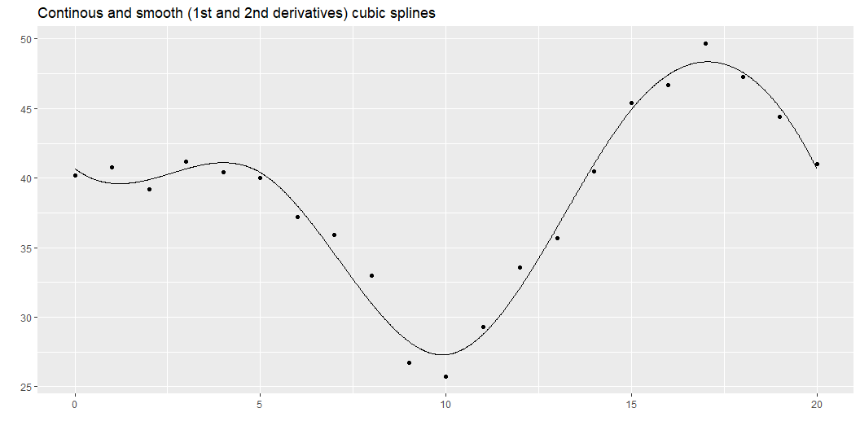
Even smoother
Notes:
Here is a function that has continuous first and second derivatives. This is a greater degree of smoothness than above and it requires only 7 degrees of freedom.
This is what most people refer to when they talk about splines: a piecewise cubic model with continuity and continuous first and second derivatives. It is a fairly simple model (not that many degrees of freedom), but it produces a curve that has the flexibility to fit a variety of curves that have the aesthetically pleasing features of continuity and smoothness.
Continuity and smoothness are more than just aesthetics, though. There are many scientific settings where we expect no jumps (discontinuities) and no abrupt turns (lack of smoothness). If you are measuring the onset of symptoms from a disease, you know that the viruses or bacteria that are causing the disease are increasing in a continuous and smooth pattern. So any problems that they cause should also increase in a continuous and smooth pattern.
Other settings, however, should not necessarily be expected to produce continuous and smooth outcomes. If a particular metabolic pathway becomes saturated or an anotomical barrier is breached, the suddenness transition could result in an abrupt turn or a discontinuity. So do think about the particular context of your problem when deciding what type of spline model to use.
This approach is simple and easy to follow, but there is one catch. There is an issue with multicollinearity.

Slide 52
Multicollinearity
S1 S2 S3 S4 S5 S6 S1 1.00 0.97 0.92 0.98 0.73 0.55 S2 0.97 1.00 0.99 0.99 0.86 0.67 S3 0.92 0.99 1.00 0.96 0.93 0.76 S4 0.98 0.99 0.96 1.00 0.79 0.59 S5 0.73 0.86 0.93 0.79 1.00 0.92 S6 0.55 0.67 0.76 0.59 0.92 1.00
Notes:
The correlations are quite high and this can lead to computational problems, including rounding errors. So most spline models implemented on a computer use a different approach.

Slide 53
Break #2
What you have learned
2. Building cubic splines from scratch
What’s coming next
3. B-splines

Slide 54
B-splines
B-splines = Basis splines
Basis is a mathematical property of a set and a subset
Mathematically equivalent to formulation shown earlier
Much less collinearity
Notes:
B-splines provide a solution with less issues of multi-collinearity.

Slide 55
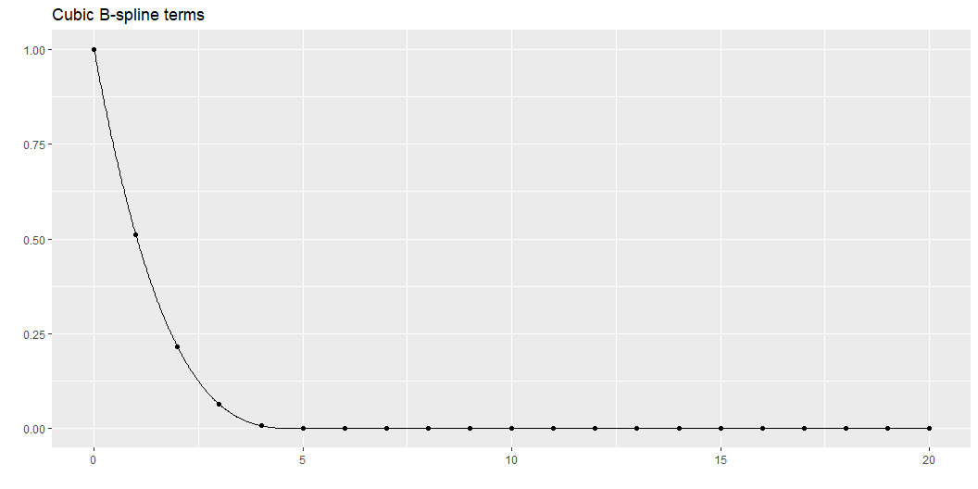
B-spline, 1
Notes:
The individual columns represent piecwise cubic polynomials. As I cycle through these graphs, notice how they are concentrated in certain intervals and there is only a partial overlap between these intervals. Also notice how they transition smoothly to zero outside those intervals.

Slide 56
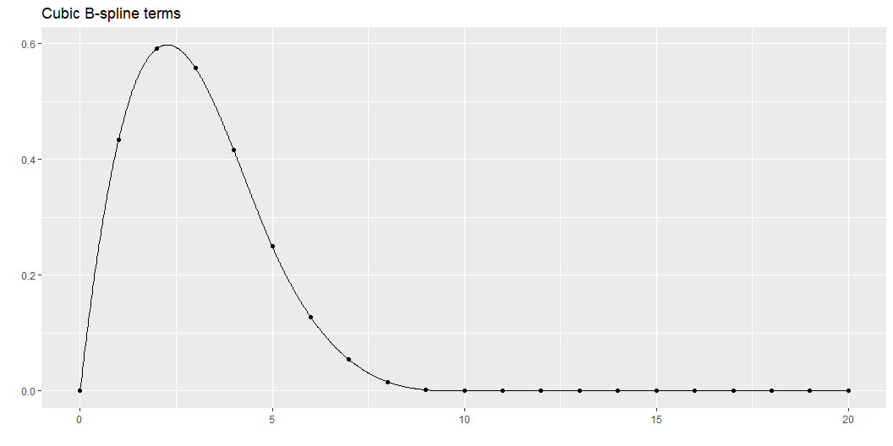
B-spline, 2

Slide 57
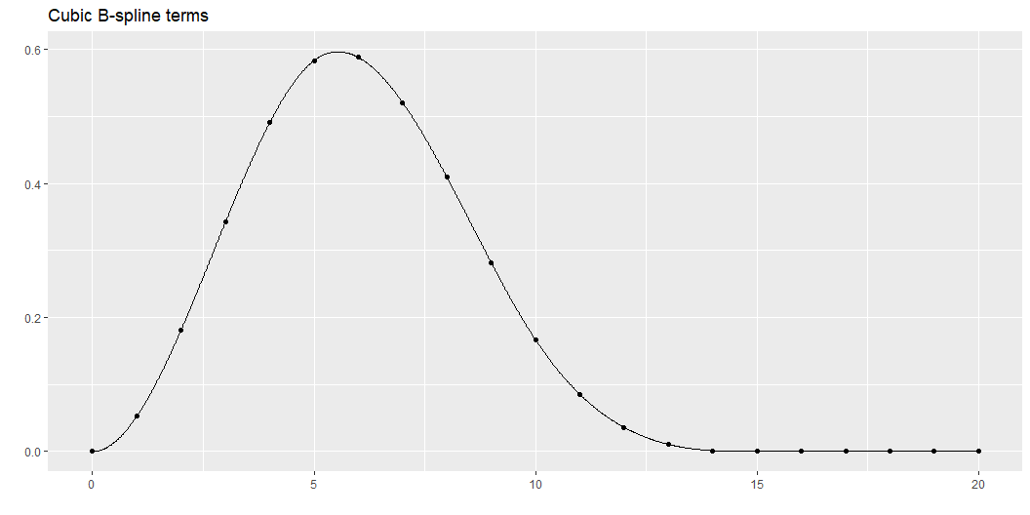
B-spline, 3

Slide 58
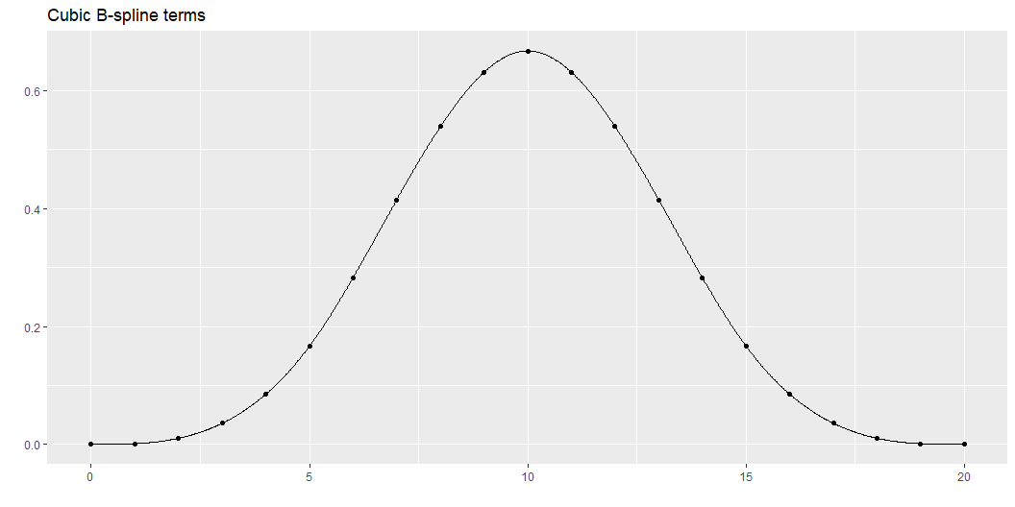
B-spline, 4

Slide 59
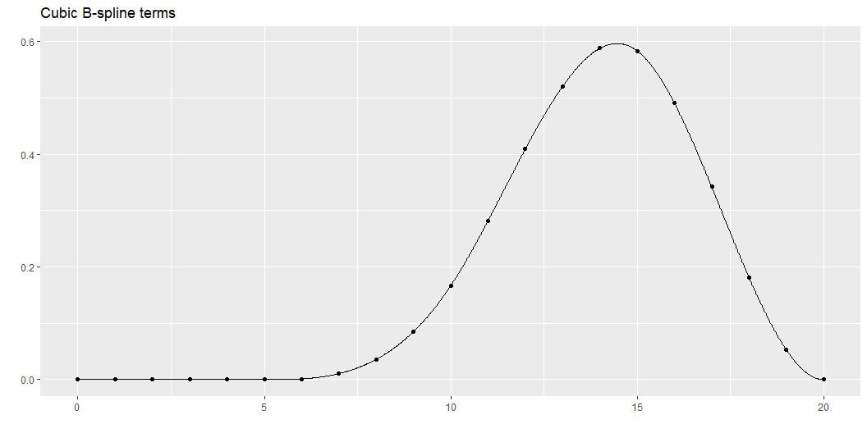
B-spline, 5

Slide 60
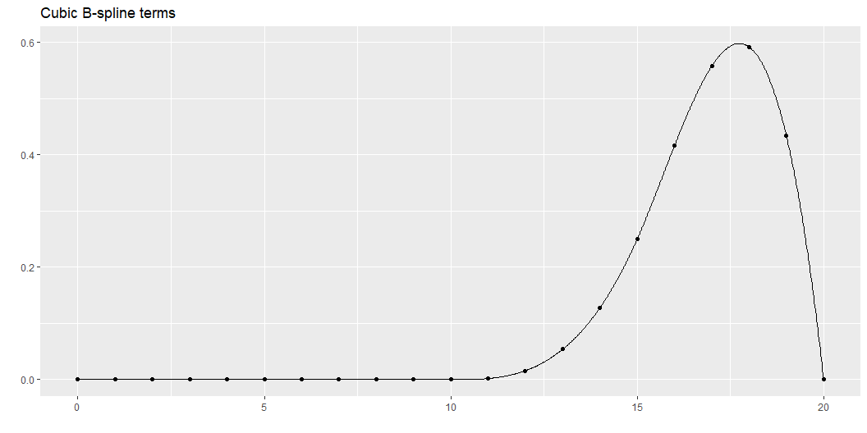
B-spline, 6

Slide 61
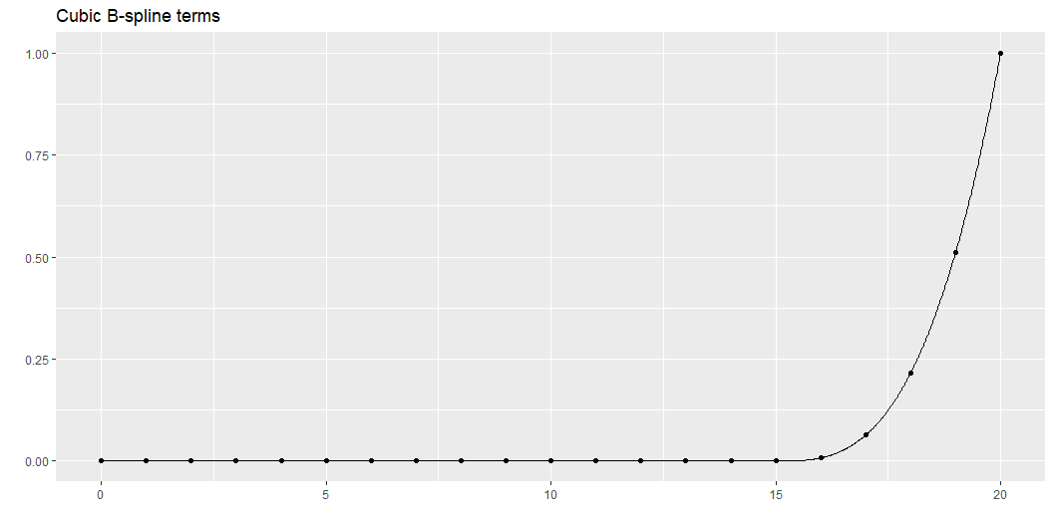
B-spline, 7

Slide 62
Correlation of B-spline terms
S1 S2 S3 S4 S5 S6 S7 S1 1.00 0.39 -0.19 -0.36 -0.30 -0.22 -0.12 S2 0.39 1.00 0.36 -0.47 -0.54 -0.39 -0.22 S3 -0.19 0.36 1.00 0.18 -0.63 -0.54 -0.30 S4 -0.36 -0.47 0.18 1.00 0.18 -0.47 -0.36 S5 -0.30 -0.54 -0.63 0.18 1.00 0.36 -0.19 S6 -0.22 -0.39 -0.54 -0.47 0.36 1.00 0.39 S7 -0.12 -0.22 -0.30 -0.36 -0.19 0.39 1.00
Notes:
Although there is some correlation, this not nearly as bad as the piecewise approach.

Slide 63
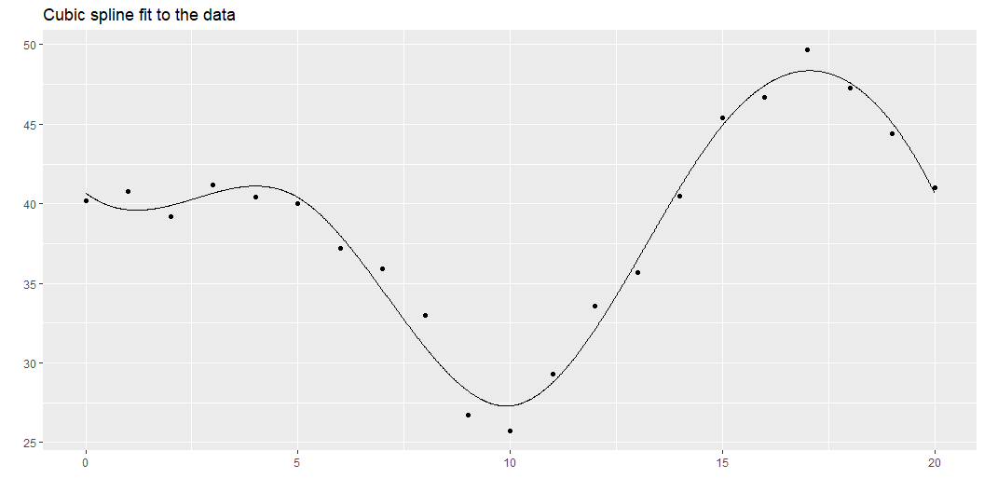
B-spline fit to the artificial data

Slide 64
Break #3
What you have learned
3. B-splines
What’s coming next
4. How many knots and where to put them

Slide 65
How many knots?
Use AIC or BIC
Eyeball the data
Frank Harrell’s suggestion
Use 4 knots if n < 100
Otherwise use 5 knots
Use your a priori beliefs
Looking at some preliminary graphs
Notes:
A difficult question is how many knots to use. Too many knots and you might end up overfitting. Too few and you might end up with not enough flexibility to fit your data well.
The AIC (Akaike Information Criterion) and the BIC (Bayesian Information Criterion) are useful measures for comparing different statistical models. In linear regression both AIC and BIC look at how close the fitted curve is to the data, but adds a penalty for model complexity. This helps avoid the situation where an excessively complex model with only marginally better predictive power is selected over a simpler model that predicts almost as well.
Note that a p-value will not work here except in some special cases where all of the knots but one coincide. The p-value fails because (with a few rare exceptions) one spline model is not nested inside another.
Look at the number of bends in the data. If the data increases to a single maximum and then decreases after that, a simpler spline with 2 or 3 knots may be sufficient. This also applies if the data decreases to a single minimum and then increases after that. If there are more bends (e.g., increase to a maximum, decrease to a minimum, and then increase again), then a larger number of knots may be needed.
Frank Harrell has a simple suggestion. Use 4 knots for small data sets. Small means n < 100. Use 5 knots for large data sets.
You may have a feel for how much complexity is appropriate based on your years of experience as a data analyst and your scientific knowledge of the process at hand. After you work with enough splines, you do get an appreciation on how wiggly they can get. If you also have a rough idea of how the nonlinear relationship is going to be, perhaps based on seeing other similar problems in the area, you can match the degrees of freedom of the spline to your expectation, prior to looking at the data.
Sometimes you have knowledge of the specific application that will help you to figure out where to put your knots.
I am not an expert on cars, but I have been told that many newer cars with automatic transmission change how the transmission behaves around 40 miles per hour. This transition helps with highway mileage. So if you are fitting a spline curve to data where how the transmission behaves, make sure that you place one or two of your knots near 40 miles per hour.
I am also not an expert on kidneys, but I have been told that the Glomerural Filtration Rate is not too critical if the value is above 90, but becomes very serious when it is less than 30. So a model looking at health effects using GFR should probably have knots around 30 and 90.
Similarly, CD4 cell counts above 500 are a good sign, but things turn rapidly worse if they dip below 200.
This is a bit controversial. Selecting a statistical model post hoc (after viewing the data) leaves you open to a charge of data dredging or going on a fishing expedition. To be fair, it is not as bad as some approaches (such as running ten tests and then choosing the one with the smallest p-value).

Slide 66

AIC for a linear fit

Slide 67

AIC for a three knot spline

Slide 68

AIC for a four knot spline

Slide 69

AIC for a five knot spline

Slide 70
Use inside knowlege to place the knots
Automatic transmission locks in at 40 miles per hour
Kidney function is fine above 90, problematic below 30
CD4 counts fine above 500, trouble below 200
Notes:
I am not an expert on cars, but I have been told that many newer cars with automatic transmission change how the transmission behaves around 40 miles per hour. This transition helps with highway mileage. So if you are fitting a spline curve to data where how the transmission behaves, make sure that you place one or two of your knots near 40 miles per hour.
I am also not an expert on kidneys, but I have been told that the Glomerural Filtration Rate is not too critical if the value is above 90, but becomes very serious when it is less than 30. So a model looking at health effects using GFR should probably have knots around 30 and 90.
Similarly, CD4 cell counts above 500 are a good sign, but things turn rapidly worse if they dip below 200.

Slide 71

Frank Harrell’s suggestion for knot placement
Evenly spaced percentiles
More knots where there is more data
Set boundary knots close to edge
For 3 knots, use $q_{0.1}$ and $q_{0.9}$
For 4-6 knots, use $q_{0.05}$ and $q_{0.95}$
For 7 or more knots, use $q_{0.025}$ and $q_{0.975}$
Example: 4 knots
Boundary knots at $q_{0.05}$ and $q_{0.95}$
Interior knots at $q_{0.35}$ and $q_{0.65}$
Notes:
Frank Harrell suggests that you place the knots not evenly across the range of X but at equally spaced quantiles of the X distribution. This makes sense when the distribution of the X values is not uniform. If, for example, X is skewed to the right (has a tendency to produce most of the data on the left with a few scattered outliers on the right), the knots will tend to favor the data-rich left side of the distribution. He also suggests placing the leftmost and rightmost knots near, but not at the extremes of the X values, such as at the 10th or 90th percentiles or at the fifth smallest and the fifth largest values in the data. The actual percentiles are a bit tricky to explain.
“For 3 knots, the outer quantiles used are 0.10 and 0.90. For 4-6 knots, the outer quantiles used are 0.05 and 0.95. For more than 6 knots, the outer quantiles are 0.025 and 0.975. The knots are equally spaced between these on the quantile scale. For fewer than 100 non-missing values of x, the outer knots are the 5th smallest and the 5th largest x.” as quoted [here][har1],
If you pick this apart, you can deduce that 4 knots for a large dataset would be placed at the 5th, 35th, 65th and 95th percentiles.

Slide 72
Knot placement doesn’t matter
Number of knots is important
Placement of knots is not important
Notes:
Most references I have looked at state that it is the number of knots rather than the placement of the knots that is critical.

Slide 73
Extensions
Natural splines
Penalized splines
More than one spline variable
Spline surfaces
Generalized additive models
Notes:
A variant on B splines are natural splines (also called restricted cubic splines). These splines place an additional restriction to the left of the first X value and to the right of the last X value. The spline is constrained to be linear at both extremes. This makes practical sense, as there is less data at the extremes, making estimation of a complex cubic function here worrisome. This also makes extrapolation outside of the range of data less problematic. Cubic polynomials have the potential of extreme shifts and if these occur outside the range of the data, they could lead to some awful extrapolations.
You should always be very careful, of course, as any effort to extrapolate beyond the range of data is [dangerous][sim3]. Nevertheless, restricting the extrapolation to a linear function is probably safer than letting the cubic polynomial wiggle around.
Penalized splines offer a way out if you are not sure how many knots to use. In a penalized spline, you put in 20 to 40 knots. This is way too many and could lead to overfitting. But then you compute a penalty term for excessive “wiggling”. It is effectively trying to minimize how much the spline coefficients change from one knot to the next.
How do you handle more than one spline variable? There are spline surfaces. The mathematics is tricky, but not terribly so. The problem is that surfaces can bend in many more ways than a line can. You can end up burning way too many degrees of freedom.
An alternative is to fit a spline for one variable and a spline for the other variables and just look at their additive effects. This is effectively the same as assuming that the splines do not interact with one another. This approach is called an additive spline model.

Slide 74
Break #4
What you have learned
4. How many knots and where to put them
What’s coming next
5. Logistic regression example

Slide 75
About the Titanic
Largest passenger ship at its time
Maiden voyage in 1912
Hit an iceberg and sank
Detailed information on all passengers
Survived (no/yes)
Sex (female/male)
Passenger class (1st, 2nd, 3rd)
Age (2 months to 71 years)
Notes:
The Titanic was a large cruise ship, the biggest of its kind in 1912. It was thought to be unsinkable, but when it set sail from England to American in its maiden voyage, it struck an iceberg and sank, killing many of the passengers and crew. You can get fairly good data on the characteristics of passengers who died and compare them to those that survived. The data indicate a strong effect due to age and gender, representing a philosophy of “women and children first” that held during the boarding of life boats. Let’s look at the effect of age on survival using a logistic regression model.

Slide 76
First few rows of data
name | pclass | age | sex | survived
Allen, Miss Elisabeth Walton | 1st | 29 | female | 1
Allison, Miss Helen Loraine | 1st | 2 | female | 0
Allison, Mr Hudson Joshua Creighton | 1st | 30 | male | 0

Slide 77
A few descriptive statistics, 1
age_mean | age_sd | age_min | age_max | n
30.39799 | 14.25905 | 0.17 | 71 | 756

Slide 78
A few descriptive statistics, 2
pclass | n
1st | 322
2nd | 280
3rd | 711

Slide 79
A few descriptive statistics, 3
sex | n
female | 462
male | 851

Slide 80
A few descriptive statistics, 4
survived | n
0 | 863
1 | 450

Slide 81

Boxplots
Notes:
The boxplots reveal little differences between the ages of survivors and deaths. If something is going on, it is subtle.

Slide 82
Fit a linear model first.
term | estimate | std.error | statistic | p.value
(Intercept) | -0.08142783 | 0.17386170 | -0.4683483 | 0.63953556
age | -0.00879462 | 0.00523158 | -1.6810637 | 0.09275054
Notes:
There may be a downward trend in the odds of survival over time, but it is not statistically significant.

Slide 83
Now fit a spline function.
term | estimate | std.error | statistic | p.value
(Intercept) | 1.2923278 | 0.39909550 | 3.2381418 | 0.0012031099
rcs(age)age | -0.1015127 | 0.02964437 | -3.4243511 | 0.0006162695
rcs(age)age' | 0.2225054 | 0.15885843 | 1.4006520 | 0.1613181579
rcs(age)age'' | -0.1409403 | 1.19790026 | -0.1176561 | 0.9063401205
rcs(age)age''' | -0.7520566 | 1.57492863 | -0.4775179 | 0.6329933910
Notes:
The coefficients from the restricted cubic spline are pretty much uninterpretable. You have to visualize the spline graphically. First do this on the log odds scale to see how far from linear the spline fit is.

Slide 84

Predictions on a log odds scale
Notes:
It looks like a definite departure from linearity. The log odds for survival are best for very young children. They decline in older children and are at their worst for young adults. The log odds rise again starting at age 30 but this is a smaller and less dramatic change than you see in the children versus young adults.
The final dip for very old passengers, starting around 45, might be real and could reflect their relative frailty. But be careful about interpreting results in the tails.

Slide 85

Predictions on the probability scale
Notes:
The ages fall on whole number boundaries and in order to see things clearly, I jittered the data.
It looks like “women and children” first might actually be “women, children, and old people first”.

Slide 86
Most models will accept splines
Easy
Linear regression
Random effects regression models
Harder but not too difficult
Generalized linear model
Cox regression
Not at all helpful for data science models
Random forests
Deep neural nets
Notes:
Splines work with a variety of statistical models. They work very nicely with linear regression and random effects regression models.
It takes a bit more work with the generalized linear model because of the nonlinear relationship with the outcome variable. With a bit of care, you will be fine.
Cox regression models also require a bit of care.
Many of the recent data science models do not work well with splines. The random forest model and deep neural nets, to name two, have their own way of modeling non-linearity and the spline functions would just get in the way.
Let me show how to use a spline in a logistic regression model with data from survival of passengers on the Titanic.

Slide 87
Spline coefficients are uninterpretable
term | estimate | std.error | statistic | p.value
(Intercept) | 1.2923278 | 0.39909550 | 3.2381418 | 0.0012031099
rcs(age)age | -0.1015127 | 0.02964437 | -3.4243511 | 0.0006162695
rcs(age)age' | 0.2225054 | 0.15885843 | 1.4006520 | 0.1613181579
rcs(age)age'' | -0.1409403 | 1.19790026 | -0.1176561 | 0.9063401205
rcs(age)age''' | -0.7520566 | 1.57492863 | -0.4775179 | 0.6329933910
Notes:
In the simple logistic regression model where age was treated linearly, you could exponentiate the coefficient to get an odds ratio. It turns out that the odds ratio for age is 0.99. Each additional year of age decreases the odds of survival by 1%. Not a lot, but it can add up across several decades of age.
You really can’t do anything with the spline coefficients. Go ahead and exponentiate them, but they won’t represent any meaningful odds ratio.
The ONLY way to interpret a spline model is through a graph.

Slide 88
Splines are a package deal
term | estimate | std.error | statistic | p.value
(Intercept) | 1.2923278 | 0.39909550 | 3.2381418 | 0.0012031099
rcs(age)age | -0.1015127 | 0.02964437 | -3.4243511 | 0.0006162695
rcs(age)age' | 0.2225054 | 0.15885843 | 1.4006520 | 0.1613181579
rcs(age)age'' | -0.1409403 | 1.19790026 | -0.1176561 | 0.9063401205
rcs(age)age''' | -0.7520566 | 1.57492863 | -0.4775179 | 0.6329933910
Notes:
The other thing to keep in mind is that the spline terms have to stick together. You can’t use stepwise regression to add or remove terms from the model and the individual p-values for the individual coefficients are misleading. You look at this output and you think to yourself that you can simplify the model by removing some of the spline terms with large p-values. You can’t do it. The spline coefficients are either all in or all out.
Now it is fairly easy to compare a spline model to a linear model. The linear model is implicitly nested within the spline model so you can just look at partial F tests, changes in R-squared, etc.

Slide 89
Don’t over-interpret the tails
Notes:
Standard errors are pretty easy to get with spline models. The mathematics behind this is tedious but not difficult. One thing that almost every spline exhibits is a fanning out of the standard errors at the extremes. This makes sense because there is less data to assess where the spline goes at the extremes.
So don’t get too worked up about unusual trends on the low end of the high end of the spline. It may be real or it may be sampling error.

Slide 90
Break #5
What you have learned
5. Logistic regression example
What’s coming next
6. Some code hints for R, SAS, Stata

Slide 91
SPSS
Nothing built in
User defined macro
Build splines by hand
Use other smoothers? (loess)
Notes:
https://community.ibm.com/community/user/blogs/archive-user/2013/06/06/restricted-cubic-splines-in-spss https://andrewpwheeler.com/2020/12/23/graphing-spline-predictions-in-spss/

Slide 92
R
splines2 package
rms pckage
Notes:
https://cran.r-project.org/web/packages/splines2/index.html https://cran.r-project.org/web/packages/rms/index.html
Aris Perperoglou, Willi Sauerbrei, Michal Abrahamowicz, Matthias Schmid. A review of spline function procedures in R. BMC Medical Research Methodology 19, 46 (2019). DOI: 10.1186/s12874-019-0666-3.

Slide 93
SAS
pbspline keyword
proc transreg
Notes:
https://documentation.sas.com/doc/en/pgmsascdc/9.4_3.5/grstatproc/n0r8r5cdax81q7n1t63rpk5rpqxx.htm https://stats.oarc.ucla.edu/sas/faq/how-can-i-use-proc-transreg-to-generate-splines-in-sas/

Slide 94
Stata
mkspline
rc_spline
Notes:
https://www.stata.com/manuals14/rmkspline.pdf https://www.stata.com/meeting/4nasug/RCsplines.pdf

Slide 95
Summary
What you have learned
Variety of regressions
Building cubic splines from scratch
B-splines
How many knots and where to put them
Logistic regression example
Some code hints for R, SAS, Stata

